Slide 1
New CMOE notification process
A step-by-step guide to completing the embedded Gateway form launched February 2025

Slide 2
Children Missing Out on Education
It is mandatory to notify the LA of any pupils in your school who are on a reduced timetable (less than 25 hours of contact/class time) and/or are attending an alternative provision
You should notify us of any pupil on a CMOE plan for more than two weeks
The way these notifications are sent to us has changed
We listened to school’s feedback on the notification method and have made changes, limited by the systems available to us, that we hope will make the process quicker and easier

Slide 3
What Has Changed?
There are no forms to download, complete and upload
01
There is now just one form, embedded into Gateway. This works in much the same way as the Leaver Notification form introduced at the start of the school year.
02
Many of the fields are tick boxes or drop downs to improve consistency and reduce the time the form takes to complete
03
Notes:
Lesson descriptions should be brief.

Slide 4
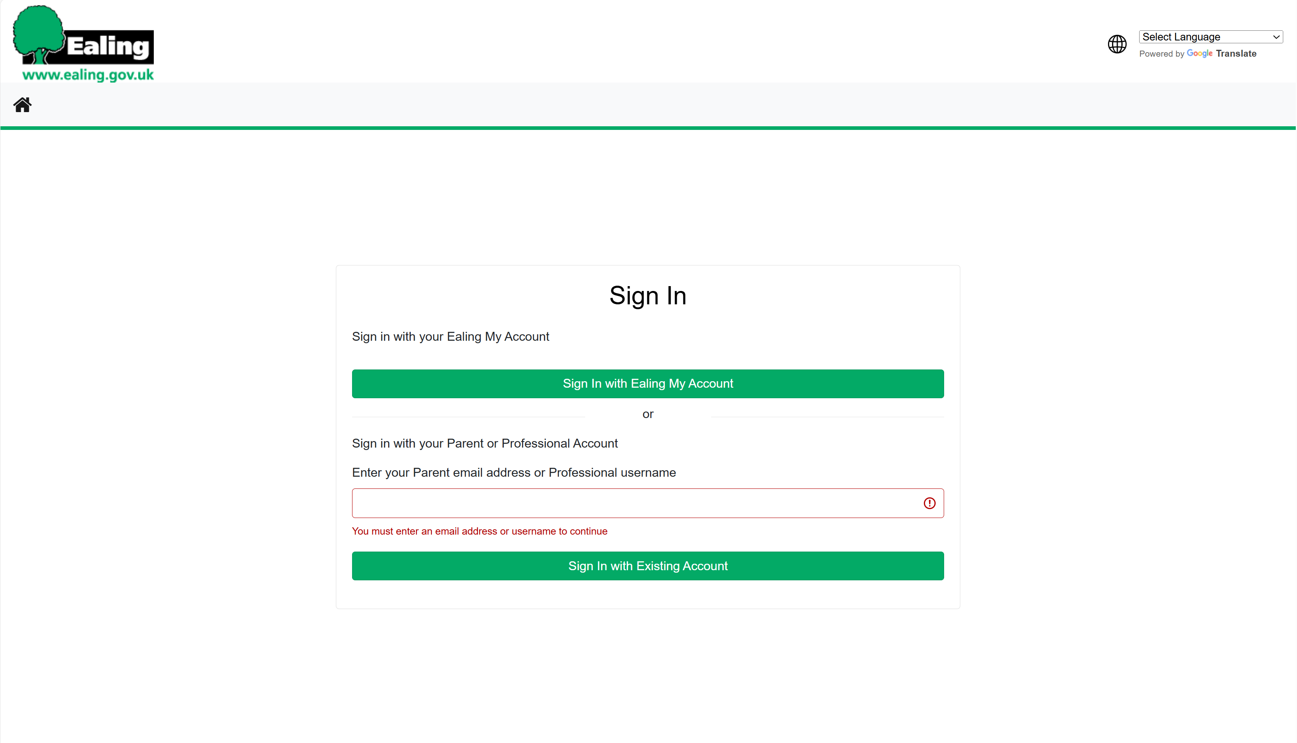
Step 1
Log into the Gateway site:
Sign In - Existing Account
If you do not have an account, please contact ealingeducationict@ealing.gov.uk

Slide 5
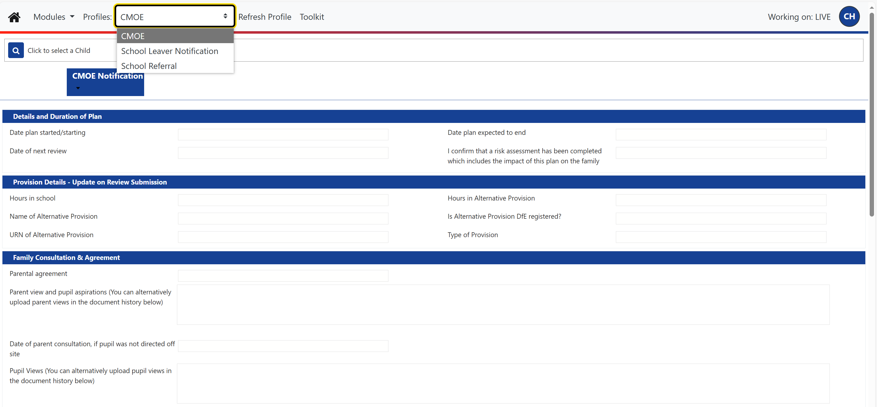
Step 2
Select CMOE from the ‘Profiles’ drop-down list.
If you cannot see this profile in the drop-down list, please contact ealingeducationict@ealing.gov.uk.

Slide 6
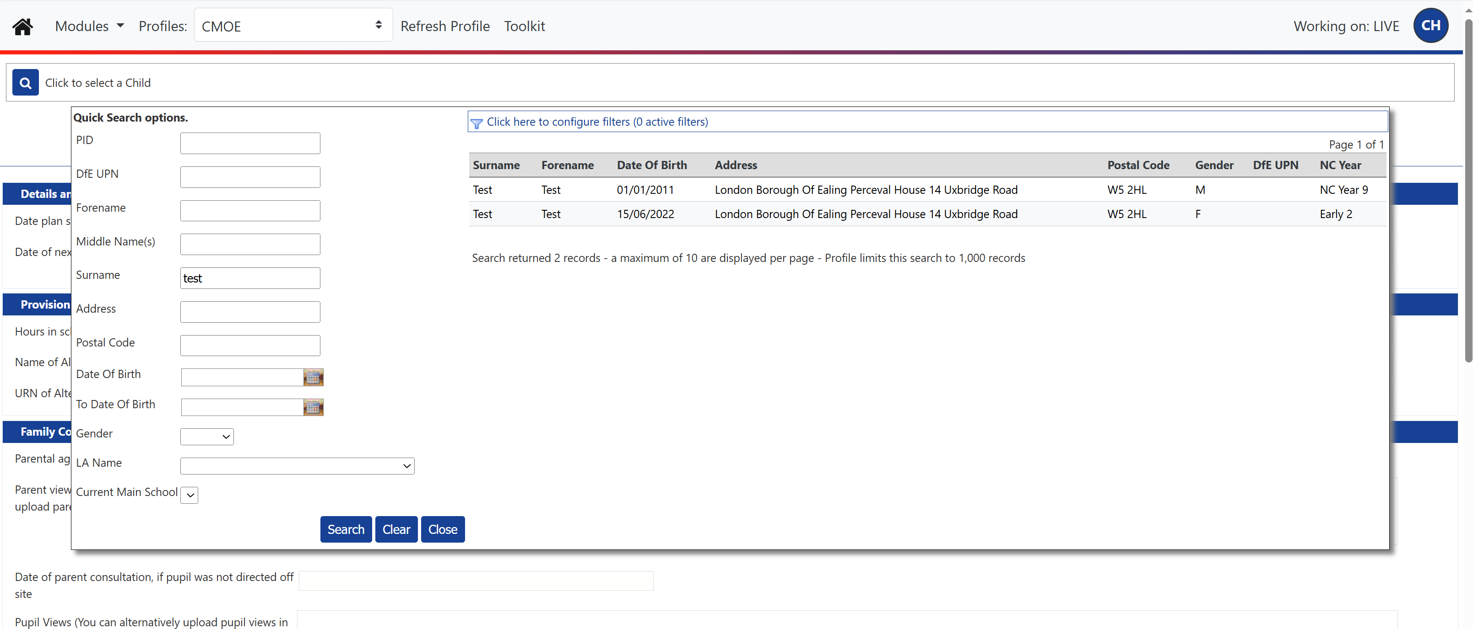
Step 3
To find the correct child:
Click on the magnifying glass
Enter their name or date of birth into the fields in the pop up
Click ‘Search’
Select the child from the list that appears on the right of the screen

Slide 7
Step 4
Click on ‘edit’ in the blue headers to access and enter information into the fields in each section.

Slide 8
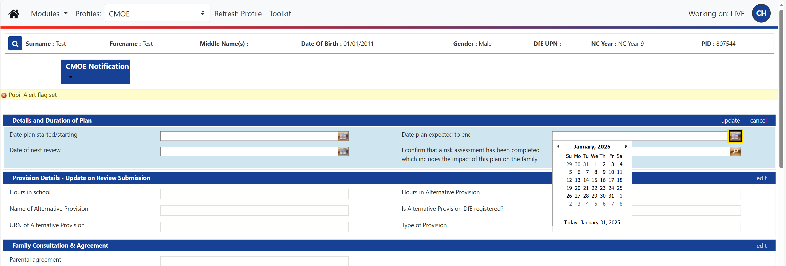
Step 5
Once you have filled in all the relevant fields click on ‘update’ to submit this data close the section.

Slide 9
Step 6
Once you have filled in all the relevant fields click on ‘update’ to submit this data close the section.
Do this for all sections except ‘Plan End’.

Slide 10
Step 7
Once you have filled in all the relevant sections click on ‘run report’ in the blue header of the ‘CMOE Submission’ section at the bottom of the page.

Slide 11
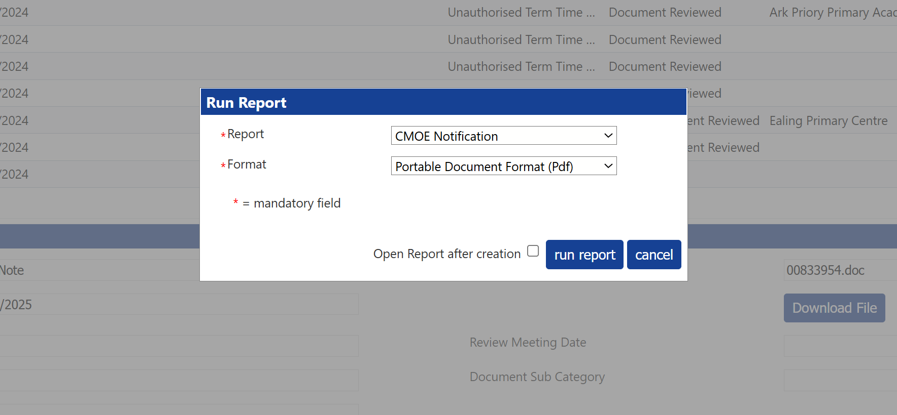
Step 8
Click on ‘Open Report after creation’ to produce a PDF document of all the information you have entered once the form is submitted.
To submit the form, click on ‘run report’ again.

Slide 12
What information is required?
Details
&
Duration of Plan
Date plan started/starting
Date of next review
Date plan expected to end
I confirm that a risk assessment has been completed which includes the impact of this plan on the family
All fields must be completed
Please be aware that though it is not required to upload a risk assessment with the plan, your Link Attendance Officer or other members of the Access Inclusion team may ask to see it at any time
Risk assessments must include consideration of the impact of the plan on the family and the safety of the pupil’s home if their plan includes periods of online learning
Provision Details
Hours in school
Hours in alternative provision
Name of alternative provision
Is alternative provision DfE registered
URN of alternative provision
Type of provision
Hours in school and hours in alternative provision must be entered as hours per week
Hours in school relates to contact/class time and can be no more than 25 hours per week
All information about any alternative provision the pupil is attending is required.
UPNs and URNs for alternative provisions can be found on these sites:
Get Information about Schools - GOV.UK (get-information-schools.service.gov.uk)
https://www.ukrlp.co.uk/
Find an Ofsted inspection report

Slide 13
…..cont
Family Consultation
&
Agreement
Parental agreement
Parent view and aspirations for pupil
Date of parent consultation
Pupil views
Parental agreement must be demonstrated unless pupil has been directed off site under section 29a. Any CMOE plan that does not have the agreement of the pupil’s parent/s is an illegal exclusion unless the pupil has been directed off site under section 29a.
Pupil views must be collected where possible and appropriate.
Parent and pupil views documents can be uploaded in the ‘Document Upload’ section if this is easier.
Reasons for Plan
Diagnosed mental illness/condition
Emotion Based School Absence (anxiety)
In-school issues
Settling in (pupil new to school)
SEN – temporary reasonable adjustment
Diagnosed Social Emotional Mental Health (SEMH)
Housing (instability, distance, overcrowding)
Long term physical illness/condition (more than two weeks)
Off site development or course
At least one reason must be selected
You can select as many reasons as are relevant

Slide 14
…..cont
Needs of Pupil
SEND code of practice
Category of SEND
SEND Code of Practice must be completed
If Education Health Care Plan or SEN Support are selected you must indicate what the pupil’s needs are.
In School Support
This field is blank but must be filled in
This field is where you let us know about all the in-school support the pupil is receiving; counselling, pastoral support, sensory room time etc. Any reasonable adjustments or support arrangements you have in place in school must be detailed here.
Other Agencies Involved
~
External Support
This is where you tell us about any support the pupil is receiving outside of school, or in school but by an external provider
You can select as many of these options as are relevant
If the support the pupil is not listed, please put their details in ‘Other Agencies’

Slide 15
…..cont
Person Initiating Plan
These fields must be completed
These fields are required so that we know who to contact if we have any queries about the pupil’s plan.
Plan End
This field should only be completed when the pupil’s plan has come to an end
Do not complete this section unless the pupil’s plan has come to an end
A reason for the plan ending must be provided (back in main provision full time or has left school)
Document Upload
This field is optional
The document upload section can be used to provide us with any additional documents you feel are relevant
It can also be used to upload parent and pupil view documents where this is easier than entering them into the relevant fields in the ‘Family Consultation & Agreement’ section
All documents uploaded must be in PDF or JPEG format
CMOE Submission
This is where the information you have entered into all of the other sections is submitted and your notification is sent to the LA
Remember to click on the ‘Open Report after creation’ box to produce a PDF with all the information you have entered when the notification is submitted. This is your copy of the plan we will receive
To submit the notification, click ‘run report’ in the pop-up box

Slide 16
What Happens Next?
Nothing! Relax and have a cuppa. Or, more likely, carry on with the dozens of other things you undoubtedly have on your to do list.
Your PDF is your acknowledgement of the plan, so we will not contact you to say we have received it. If you are at all concerned it hasn’t been submitted correctly, please contact cmoe@ealing.gov.uk or ask your Link Attendance Officer to check it has been received
01
Once the notification is submitted a member of the Inclusion team will get in touch directly if they have any questions or ask your Link Attendance Officer to contact you for clarification.
02
Assess, plan, do, review.
You assessed, you planned, you did, and now it’s time to review.
See the next section for information on how submit your review and how to notify us when a plan ends.
03
Notes:
Lesson descriptions should be brief.

Slide 17
Reviews
All CMOE plans must be reviewed regularly; at minimum, every six weeks
Parental agreement must be confirmed at each review. Parent views must be obtained at each review, as must pupil views wherever possible and appropriate
To submit a review on Gateway, follow steps 1 - 3 on slides 4 – 6 to locate the pupil. Then follow steps 4 – 7 on slides 7 – 10, updating all relevant information in the fields of each section and submit the review, as per the instructions in step 8 on slide 11.
Remember to click on the ‘Open Report after creation,’ box to produce a PDF with all the information you have entered when the notification is submitted. This is your copy of the plan we will receive
We will not contact you upon receiving the review unless we have questions about the plan or need you to clarify some of the details entered

Slide 18
Notifying us about a plan that is ending
Please make sure you notify us if a CMOE plan for one of your pupils is ending or already ended. If you do not let us know we will assume you have failed to review the pupil’s plan and will contact you for an update
Plans should not go on indefinitely, especially if the pupil is not engaging and/or the plan is not producing (or at least heading towards) the desired outcome, which is among the reasons regular reviews are so important. Most plans should last six weeks, twelve at most if the support put in place needs a little more time. There are very few circumstances where plans should last longer than twelve weeks. Please see the guidance on EGFL for more information on plan durations - Pupils on reduced timetables and in alternative provisions or remote education 2024.pdf
To submit a plan end notification on Gateway, follow steps 1 - 3 on slides 4 – 6 to locate the pupil. Then follow steps 4 – 7 on slides 7 – 10, updating just the ‘Plan End’ section and submit the notification, as per the instructions in step 8 on slide 11.
Remember to click on the ‘Open Report after creation,’ box to produce a PDF with the information you have entered when the notification is submitted. This is your copy of the notification we will receive
We will not contact you upon receiving the notification unless we have a query about the details submitted

Slide 19
Queries & Further Information
Hopefully, this guide has answered many of your questions about submitting a CMOE plan notification. If you have any burning questions not answered here or require any further information, please see the following sources:
Gateway account logins or difficulty: ealingeducationict@ealing.gov.uk
Trouble finding a pupil on Gateway or pupil information that is incorrect: ealingeducationict@ealing.gov.uk
Guidance on CMOE plans:
Pupils on reduced timetables and in alternative provisions or remote education 2024.pdf
General CMOE queries:
cmoe@ealing.gov.uk or speak to your Link Attendance Officer

