Slide 1
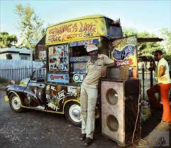
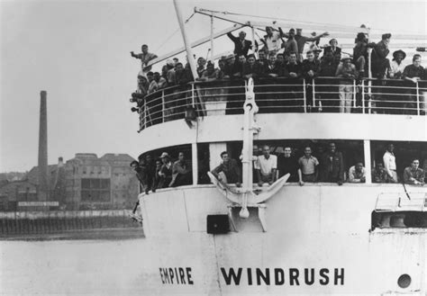
75 years since the Windrush generation arrived
The Windrush generation refers to the people who left the caribbean countries and arrived in the UK between 1948 and 1971
Redemption Song
https://www.youtube.com/watch?v=kOFu6b3w6c0

Slide 2
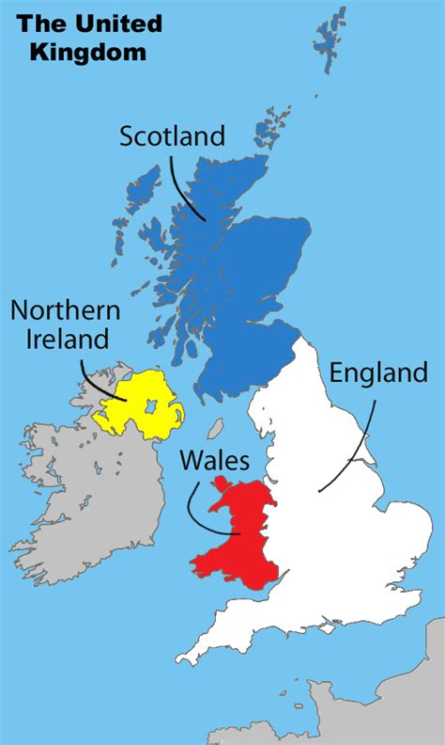
In 1948, Britain was beginning to recover from WWII.
They invited people to come to Britain from the Caribbean because there was a shortage of people to fill job vacancies. In years to come they also invited people from other colonies.

Slide 3
There are people who come to Britain all the time, so what makes this migration unusual?
They were illegal immigrants
B) The people who came were invited and persuaded to come by the British government.
C) The people from the caribbean were trying to get British citizenship.

Slide 4
There are people who come to Britain all the time, so what makes this migration unusual?
They were illegal immigrants
B) Britain invited and even persuaded people to come to the UK.
The British government sent people from Britain to the islands to persuade people to move to the UK.
C) The people from the caribbean were trying to get British citizenship.
The British Nationality Act 1948 said that all people living in the British colonies had automatic citizenship and rights to work in Britain. So the windrush generation were already British citizens.

Slide 5
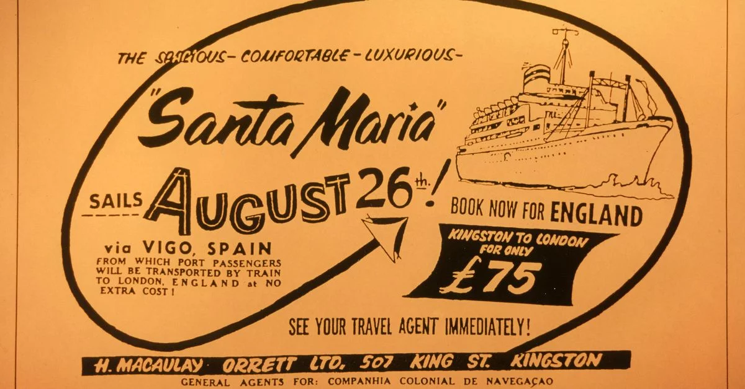
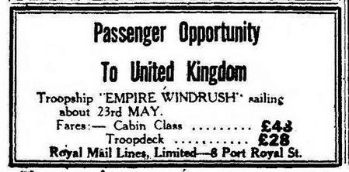
If someone invites you to their home, how do you expect to be treated? Why?
https://www.bbc.com/news/av-embeds/uk-43782241/vpid/p065w53b
Notes:
https://www.bbc.com/news/av-embeds/uk-43782241/vpid/p065w53b
Sam King MBE speaking about arriving on the empire windrush. (2 minutes).
The unions blamed Black people for things going wrong because it was ran by a popular fascist Oswald Mosley. (More about him later).

Slide 6
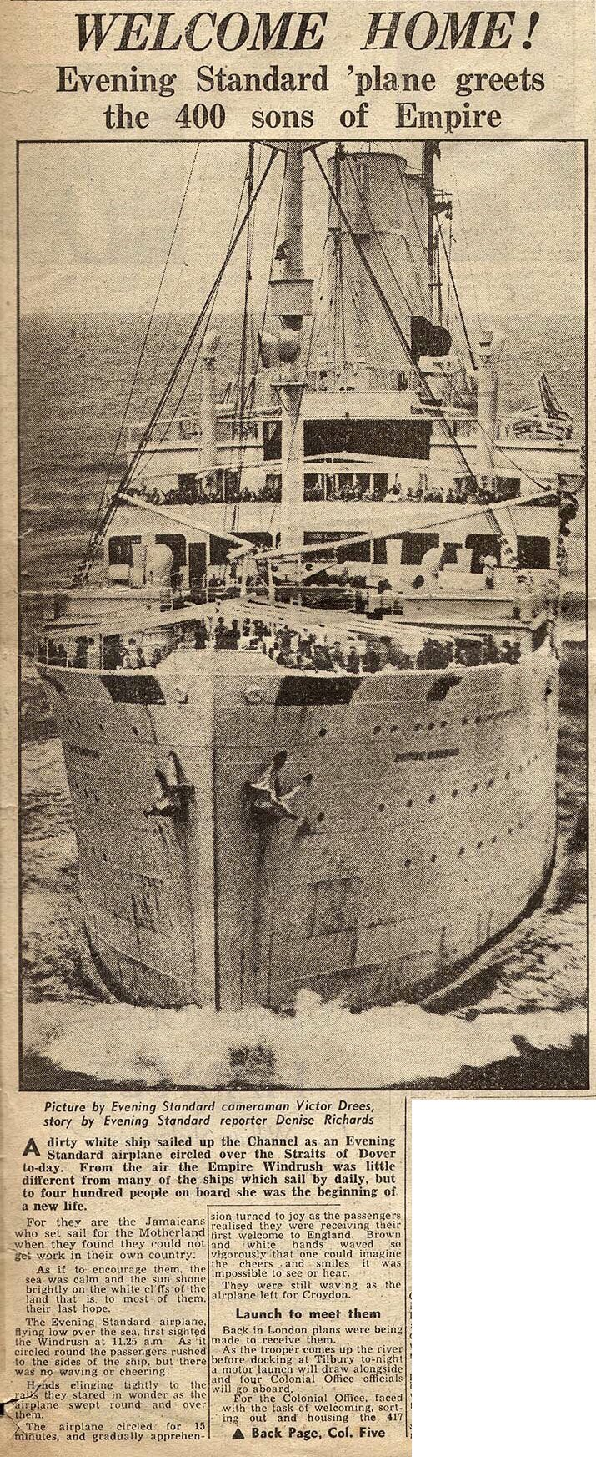
If someone invites you to their home, how do you expect to be treated? Why?
1948 June 22nd newspaper labels the people who arrive as “sons of Empire” and tells them “Welcome Home”.

Slide 7
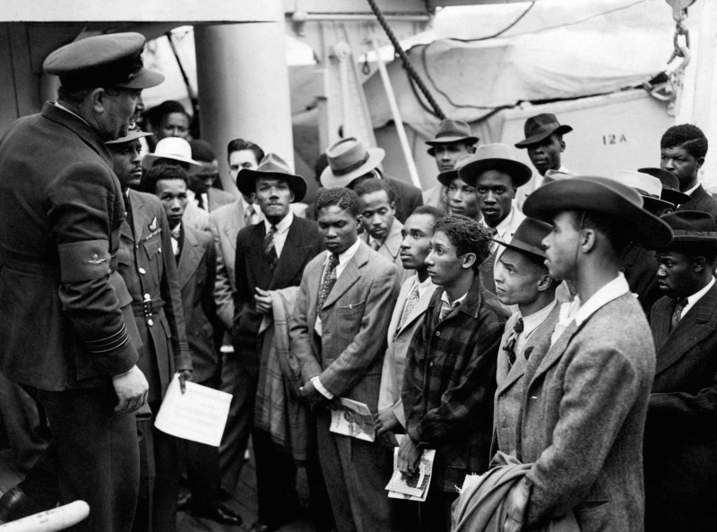
Welcomed on arrival
Jamaican immigrants welcomed by RAF officials from the Colonial Office after the ship 'Empire Windrush' landed them at Tilbury in 1948. These were the first arrivals.
The group who migrated are named after the Empire Windrush, a ship that docked near London in 1948 carrying the first group of migrants from the Caribbean who had been invited by the government to relocate to Britain to help fill a labour shortage after World War II.

Slide 8
How have the Windrush generation have contributed to life in Britain?

Slide 9
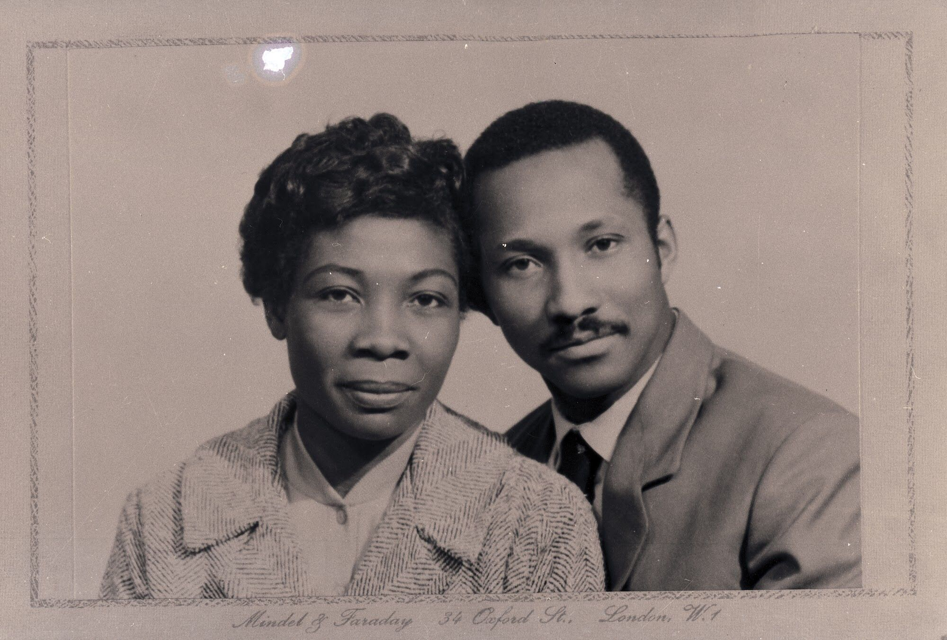
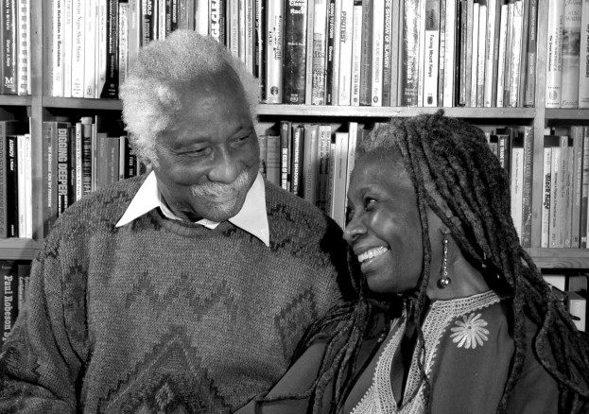
Eric and Jessica Huntley founded a publishers in 1974, and the Walter Rodney bookshop in Ealing, West London.
The Huntleys were passionate about education . They opened a book shop and publishing house, Saturday school for children and helped organise events in the community.
Think about it! Reading books was the only way to educate yourself in the 1970’s. It was before Google, YouTube, or the internet.
Reading books was the only way to learn history, and the thoughts and opinions of others. 🤔
Notes:
The Huntleys were passionate about education and believed it was essential for Africans and African Caribbeans to make progress and build a better future. They opened a book shop and publishing house in the west London borough of Ealing, where Black writers could get their books published, read the work of other authors and educate themselves. Due to racism, Black authors found it hard to get their books published, and they found it equally hard to get hold of books and writing by Black authors, and books that would inspire and encourage their progress.
Reading books was the only way to educate yourself in the 1970’s. It was before Google, youtube, or the internet. And so reading books and having access to information about the history and thoughts and opinions of others was even more essential for any group of people to progress.
The Huntley’s opened a Saturday school for children so that they could learn without racism and they helped organise the 1981 Black People’s Day of Action march that attracted 20,000 black Britons from all over the country and was the largest protest march of black people. They also helped organise action against discrimination in schools and racist violence against school aged children, including the Black Parents Movement (BPM) formed in 1975 following the arrest and assault by Haringey police of a Black schoolboy named Cliff McDaniel outside his school.
However, their shop had come under racist attack by people who wanted it shut down. The Huntley’s did not let this stop them. They continued on their mission to spread knowledge and set up the Caribbean Education and Community Workers Association (CECWA), where they worked with others in the community to continue improving education for Black people in Britain. In 2005 the Huntleys deposited their archives at the London Metropolitan Archives (LMA).

Slide 10
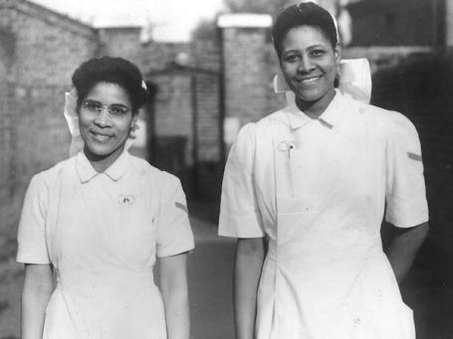
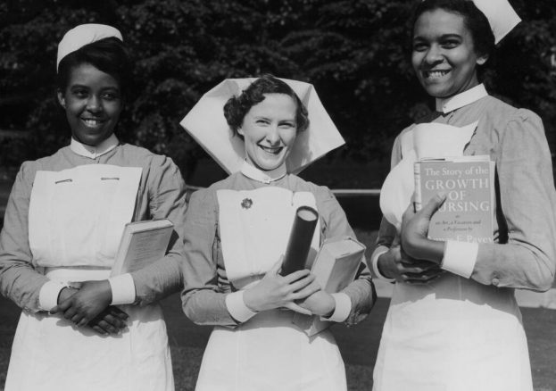
Qualified nurses came to work in the NHS.
The NHS had just been formed in 1948, but Britain didn’t have enough qualified people to fill the roles.

Slide 11
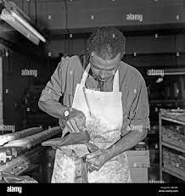
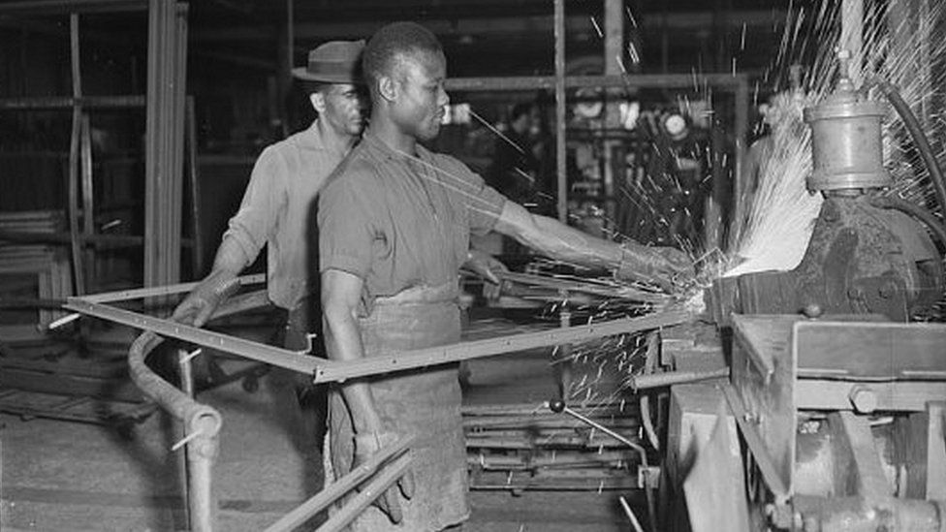
Many worked in factories and as builders.

Slide 12
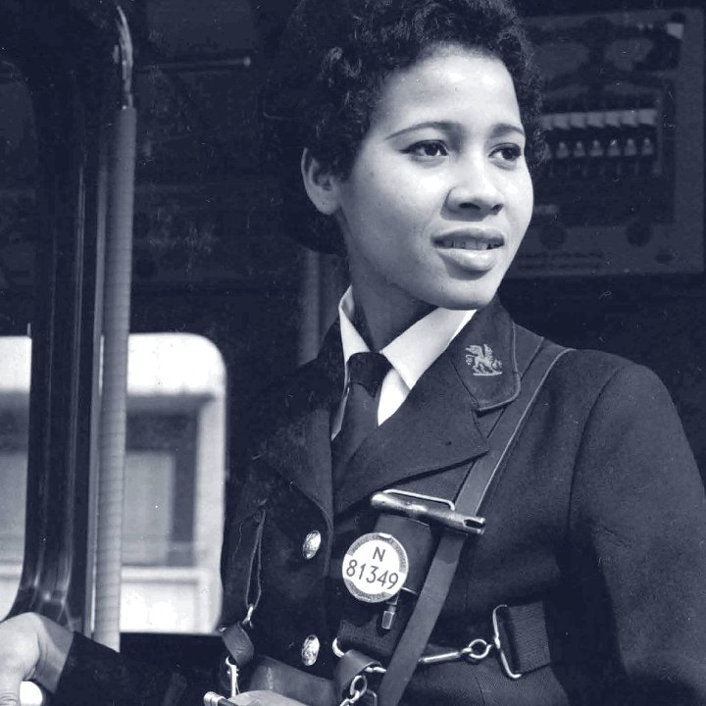
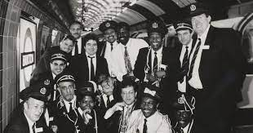
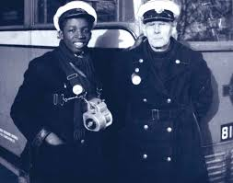
And in the transport industry…

Slide 13
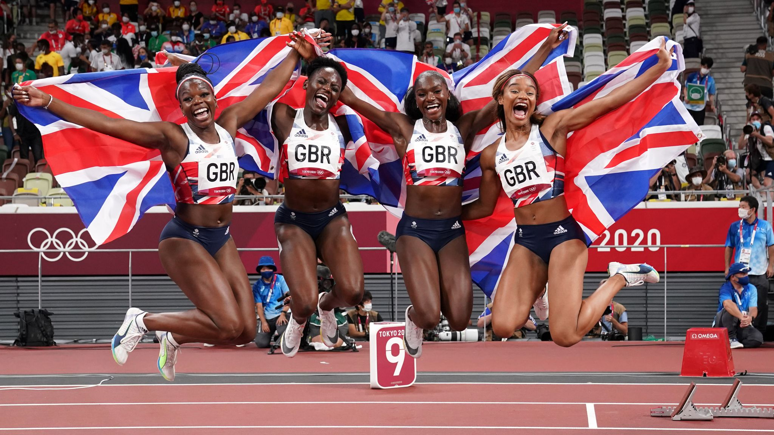
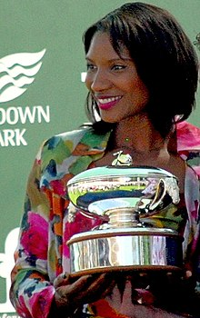
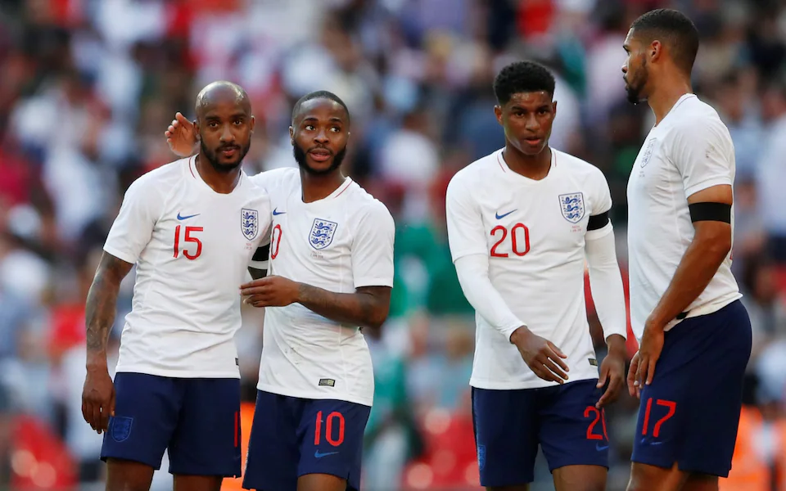
And some have even represented Great Britain in sport.
Denise Lewis - athlete and presenter.
5th Oct 2019 men and womans’s relays teams win silver.
Tokyo 2020 Olympics - Bronze medal relay team.

Slide 14
And some individuals who have achieved success include…

Slide 15
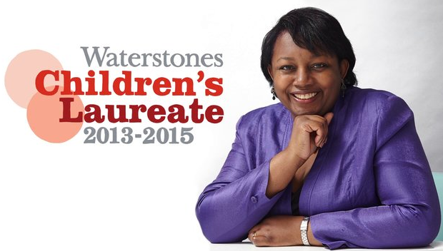
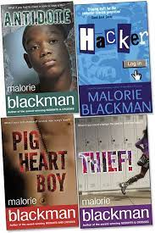
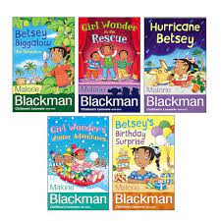
Malorie Blackman - Author and children’s Laureate, 2013.
Malorie Blackman was born in Clapham, London, and grew up in Bromley, one of five siblings. Her parents were both from Barbados and had come to Britain as part of the "Windrush generation". Her father was a bus driver and her mother worked in a factory. They worked hard and taught Malorie the same.
Malorie Blackman has written over 60 books, was appointed Children’s Laureate – in June 2013, and was named the most influential person in Britain.

Slide 16
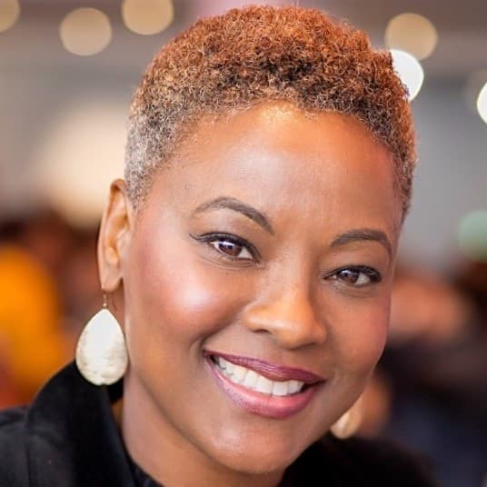
Samantha Tross - Orthopaedic surgeon and winner of the Clinical Excellence Award for her service to the NHS.
In 2018, Samantha Tross was the first woman in Europe to perform robotic hip surgery. Dr Tross is currently the Lead Orthopaedic Surgeon at Ealing Hospital. She has also been named in Tatlers 100 most Influential doctors in the UK in 2013.
Samantha Tross, a Guyana-born (African Caribbean) consultant surgeon who shares her knowledge and skills by mentoring others in the field of medicine and also teaches internationally, including in London and Nigeria.

Slide 17
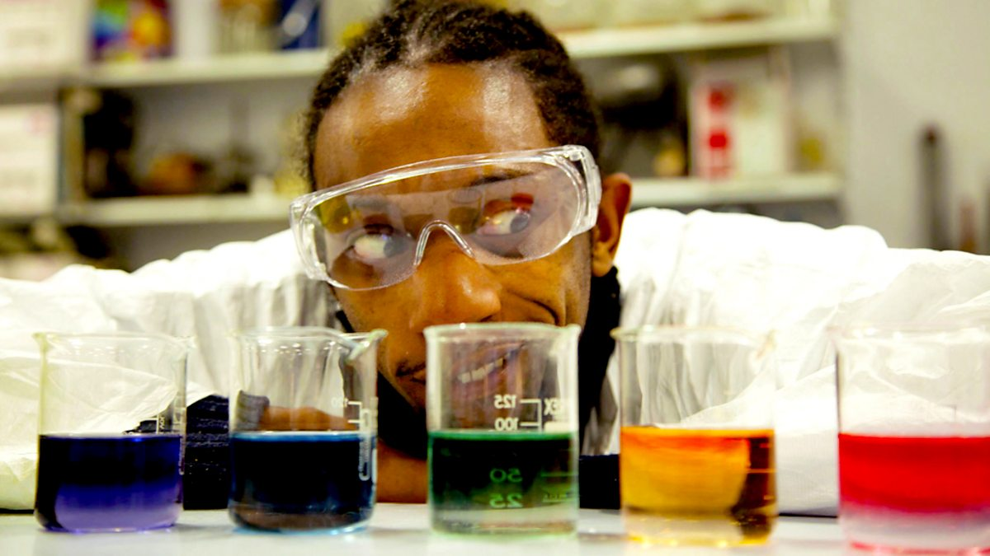
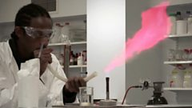
Jonathan Chase - never gave up at science.
Jonathan’s parents arrived during the Windrush from Barbados. Chase attended Twyford High school in Acton, London. He took A levels in physics, pure maths and computer science and went to university to study aerospace engineering. He was unhappy with his degree grade, and decided to take a second degree in science, and achieved a upper second class honours.
Proud of his achievement, he continued to challenge himself and did a Masters degree in communicating science and achieved distinctions! He became an associate lecturer at the university for some time.
Chase combined his love for hip hop music, science and maths to write hip hop style raps for young people. He performed his scientific raps on BBC bitesize and even made a video for NASA about astrobiology.
Here is one on equivalent fractions: https://youtu.be/uvLi3C_5rWg (Listen here)
Notes:
Jonathan’s parents arrived during the Windrush from Barbados. Chase attended Twyford High school in Acton, London. Chase took A levels in physics, pure maths and computer science and went to university to study aerospace engineering. He was unhappy with his low degree grade, and decided to take a second degree in science where he achieved a upper second class honours. Proud of his achievement, he continued to challenge himself and did a Masters degree in communicating science and achieved distinctions! He became an associate lecturer at a university for some time.
Jon says he had challenges along the way, but he will not allow anyone to hold him back, and he doesn’t make excuses for his shortcomings.
He combined his love for hip hop music, science and maths to write hip hop style raps for young people. He performed his scientific raps on BBC bitesize and even made a video for NASA about astrobiology.

Slide 18
How have the Windrush generation have contributed to life in Britain?

Slide 19
After 75 years since the arrival of the Windrush generation, we are thanking the ‘Windrush’ generation and their children for helping to…
Rebuild Britain after the war…
Re-build Britain after the war…
Keep transport running after the war…
Develop and sustain the NHS
Get laws changed to improve race equality for all people in Britain

