Slide 1
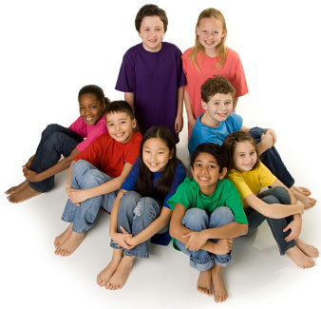
Li: I feel good about the ways
we are the same and different

Slide 2
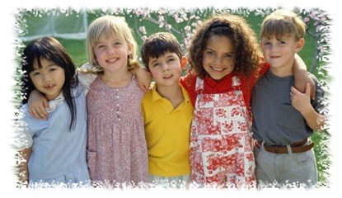
Let’s talk .....
How are we the SAME?
How are we DIFFERENT?

Slide 3
GAME:
Choose 5 children to stand at the front of the class.
Choose another child to describe one of them.
“This person has ........”
“This person likes.......”
“This person is good at........”
“This person usually..........”
Who can guess who is being described?
Swap over.

Slide 4
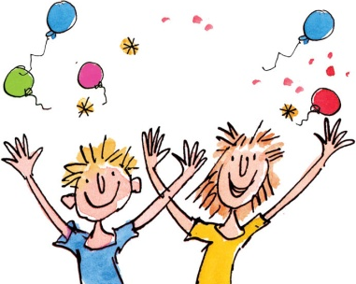
Li: I feel good about the ways we
are the same and different.
Name:
This is me!
This is my friend!
Talk about what is the same and what
is different about the two of you.

