Slide 1
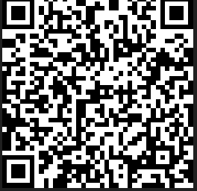
EBSA Parent Survey QR Code
Is your child struggling with school attendance?
Share your insights anonymously through the Emotional-Based School Absence Parent Survey by scanning the QR code.
Your input will help us understand challenges, concerns, and best practices, shaping future support for your child, their school, and parents across the borough.
Thank you for making a difference!
Notes:
Please scan this QR code to access the parent survey.

