Slide 1
Virtual walkthrough of revised PSHE scheme of work

Slide 2
Accessing the session
PowerPoint will be sent to all participants after the session
Scheme of work is on the Ealing Grid for Learning – schools will also be sent a USB with SoW
Please mute your microphone on Teams and remove your video – as these can slow down the connection

Slide 3
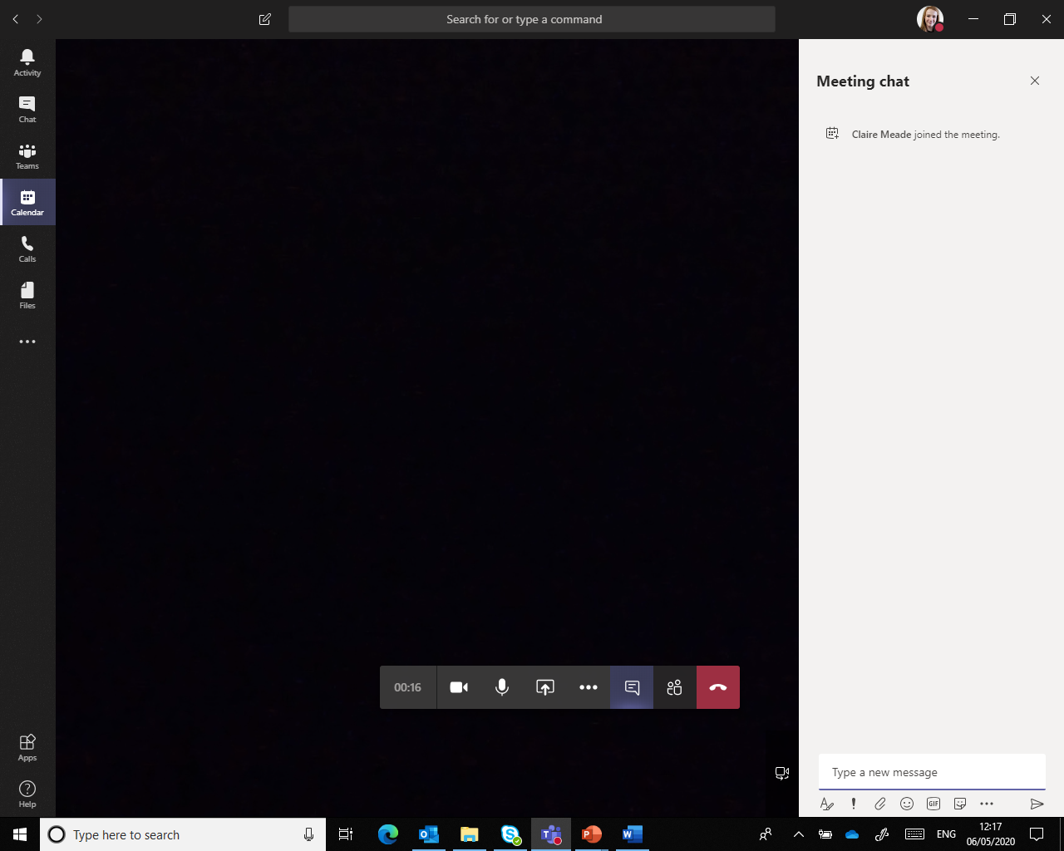
Asking questions as we go
Use the conversation function on Teams
You can write your question in the conversation tab and I will answer as we go
You can just say you have a question and I will then give time in Q & A session to unmute and ask your question

Slide 4
Focus for today’s session
Increased understanding of the new PSHE scheme of work
Increased knowledge of how to use the SOW to assess and evidence PSHE
Q & A based on the revised scheme of work

Slide 5
Why is the update needed for our current SoW?
Last revised in 2017
This year DfE published ‘Statutory Relationships and Health Education’ guidance
This makes Relationships and Health Education statutory in all schools from September (see briefing document on EGFL)
Previously PSHE was not a statutory subject

Slide 6
Why is the update needed for our current SoW?
We needed to revise SoW to ensure it meet all requirements for DfE guidance
Needed to add some lessons
Needed to remove some lessons (to make space)
More lessons which promote protected characteristics (age, disability, gender reassignment, race, religion or belief, sex, sexual orientation, marriage and civil partnership and pregnancy and maternity)

Slide 7
What topics are included in PSHE?
Personal
Social
Health
Economic

Slide 8
Drugs, alcohol and tobacco
Nutrition
Obesity
RSE
Equality
E-safety
Mental health and resilience
Stress and anxiety
Managing risks
Bullying and friendship
Safeguarding
Gender
Managing emotions
Prevent
Keeping safe
FGM
Social skills
Conflict resolution
Where to get help
poverty
charity
The needs of others
British Values
Rights and needs

Slide 9
Scheme of work layout

Slide 10
Three themes: the same as previous SoW
Health and wellbeing
Autumn
Living in the wider world
Spring
Relationships
Summer

Slide 11
Whole school events

Slide 12
Safeguarding
Notes:
Each lesson begins with reference to British Values and with reference to the PANTS rule.
PANTS
RSE
FGM

Slide 14
Allergies
We have added an assembly and sample lessons (Ks1 and KS2) on allergies.
These can be used as needed in your school.
These resources can be found in:
Short Term planning
Autumn
Allergy resources

Slide 15
Using the scheme of work

Slide 16
Using the scheme of work

Slide 17
Circle time games
This folder has lists of additional circle time game. These are split into:
General
KS1
Lower KS2
Upper KS2
These can be used as starters to PSHE lessons or as an additional activity/lesson
Guidance for scheme of work
Pupil conferencing questions (split into themes and year groups)
Whole school resources (calendar, contact list, overview)
Guidance document (how to use the SoW)
PSHE and Ofsted document
DfE coding sheet

Slide 18
DfE statutory guidance has laid out 5 themes that are statutory in relationships Education and 8 themes that are statutory in Health Education.
I have given each theme a letter, and each objective within that theme a number.
This makes is easier to identify where certain themes/objective are taught across a school.

Slide 19
INSET for staff
Sample PowerPoint you can use in school to deliver INSET of using the PSHE scheme of work
Long term planning
This excel document shows the coverage of the DfE themes and objectives across year groups.
Split into terms and then has an overall summary
DfE objectives (with letters and numbers) are across the top, with year groups down the side

Slide 20
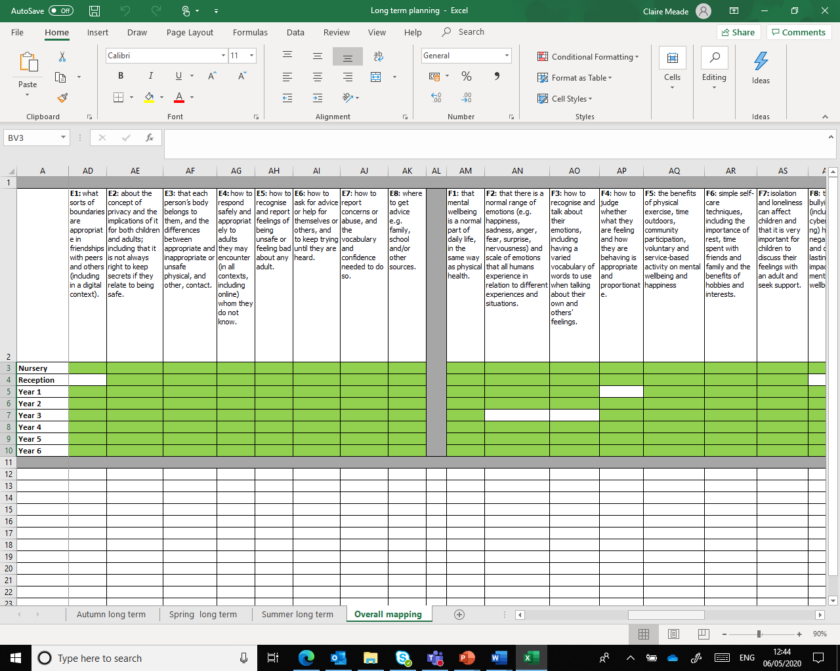

Slide 21
Medium term planning
One for:
Autumn
Spring
Summer
Summarises what is covered in year group during each term.
Short term planning
Split into:
Autumn
Spring
Summer
Then divided into year groups. Has planning and resources for all lessons
Also has resources needed for launch and end events

Slide 22
Short term planning
12 lessons per year group per term.
It is important to teach the lessons as they are mapped out as this ensures that all children are working on the same theme at the same time.
Lessons should be between 40 – 60 minutes.

Slide 24
Year 1
Living in the wider world
Lesson 1

Slide 25
PSHE
What does PSHE stand for?
Personal
Social
Health
Economic

Slide 28
R - Respect
O – Openness
C – Confidential
K - Kind

Slide 30
Assessment – same as previous scheme
Pupil assessment
Teacher
assessment

Slide 32
Teacher assessment
In the scheme of work assessment opportunities are coloured red.
Draw and write assessments.
Assessments should be put in children’s PSHE books. Samples can be photocopied for PSHE folder.

Slide 33
Evidence
The colour blue is used to highlight opportunities to gather evidence.
Teachers should use these opportunities to ensure they gather necessary evidence for each lesson. Evidence can be gathered in a number of ways: photographs of activity with captions, samples of learning, samples of children’s responses, samples of group work, samples of pupils’ contributions to class discussion.
Evidence should be put in children’s PSHE books. Samples can be photocopied for PSHE folder.

Slide 34
PSHE folder
This PSHE folder should be split into 3 sections, one section for each term.
At the beginning of each section, the teacher should insert the learning objective overview for the term, this will help teachers to record evidence for each of the relevant lessons.

Slide 36
PSHE folder
Photocopied samples of evidence and assessment should be kept in this PSHE folder.
Use the learning objective overview to date samples of assessment and evidence.
Keep a class register in PSHE folder so all children’s learning is reflected.

Slide 37
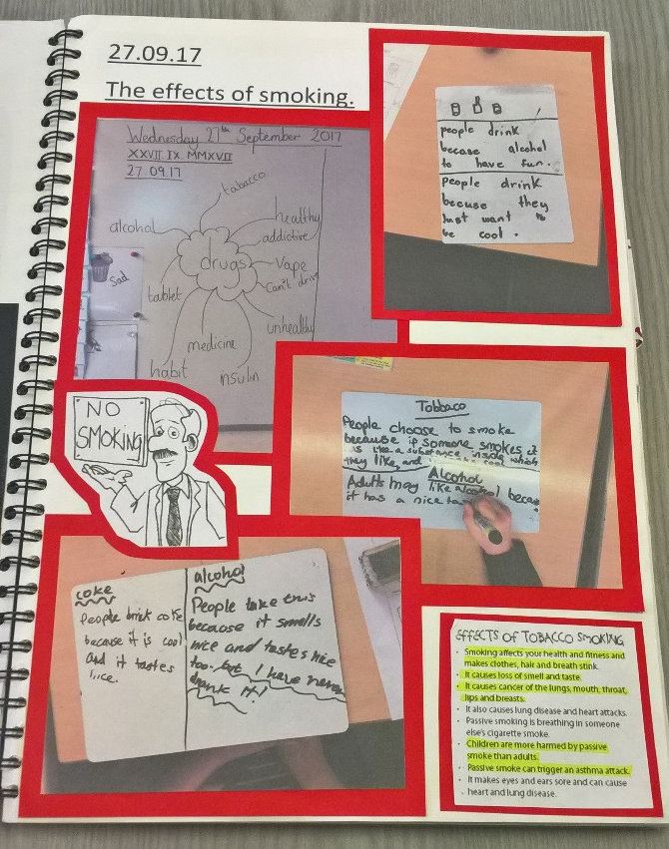
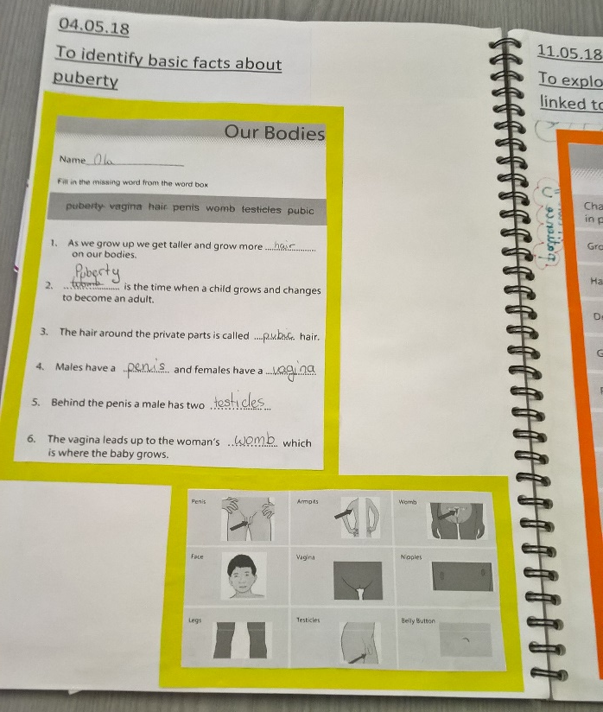

Slide 38
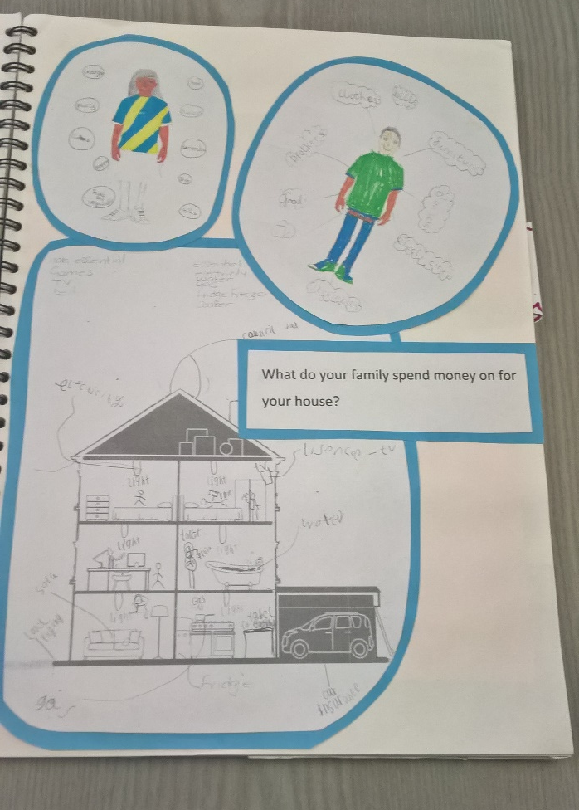
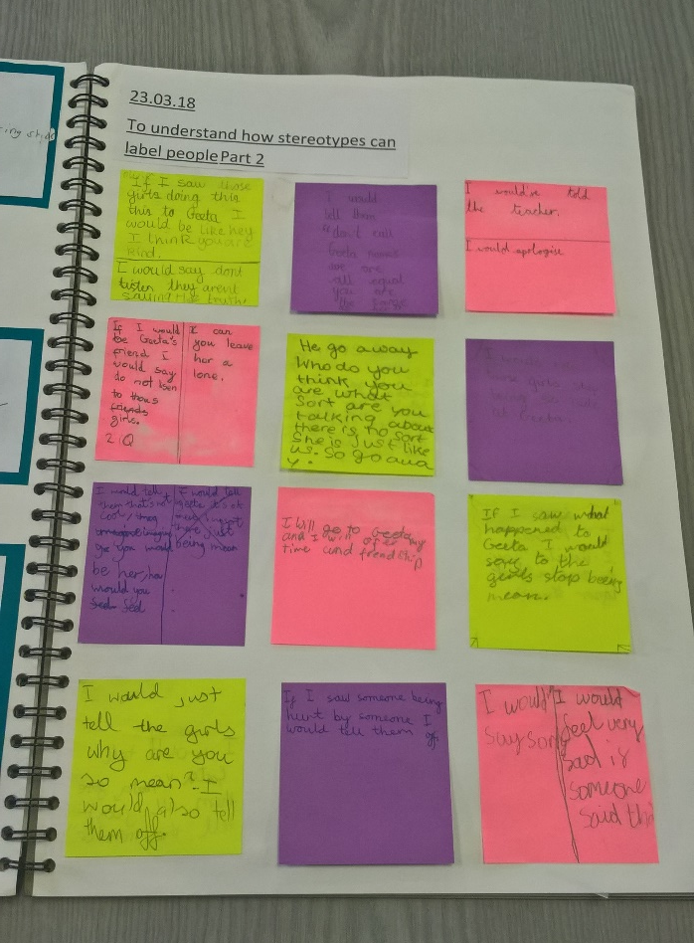
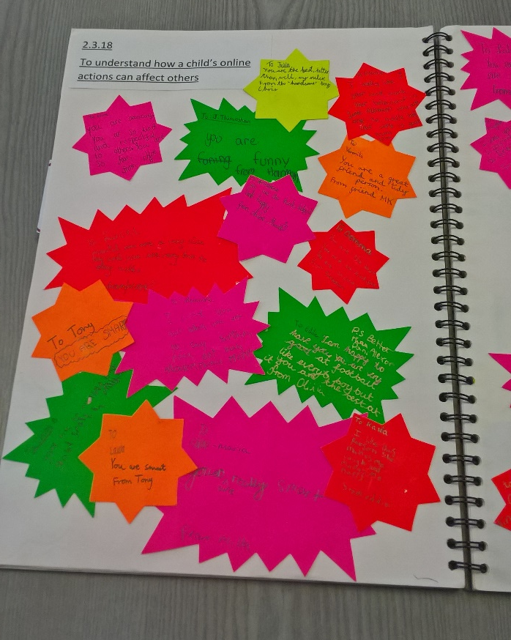

Slide 39
First Aid lessons
Taught in Year 6
Lessons 7, 8 and 9
Lessons are long : are designed to be taught after SATs as half day activities, or as part of a First Aid Day.
Could also be part of transition work
Teachers can shorten lessons if needed

Slide 40
Relationships Education lessons in scheme of work
Specific Relationships Education lessons (RSE) taught in Summer term in all year groups.
We no longer use the Christopher Winter resources for relationships education, we have written our own lessons
These lessons are identified on the lesson plan as ‘Relationships Education lesson 1’

Slide 42
Relationships Education lessons in scheme of work
Parents can only withdraw from 1 Relationships lesson in primary school – Year 6, Summer, lesson 4 (relationships education lesson 3).

Slide 43
FGM lessons in scheme of work
Taught in Summer term in Years 3 – 6
2 lessons per year group
We strongly advise schools to work with parents and staff before delivering these lessons to ensure that everyone is confident with the lesson delivery.
In resource pack a top tips for teachers for these lessons is available. There is also a letter that can be sent to parents prior to delivering these lessons.
These lessons are not statutory, and parents can withdraw their children form lesson 5 and 6 if they so wish.
If your school decides they are not ready to deliver these sensitive lessons yet, please use alternative lessons provided

Slide 45
Type question directly into conversation box
Type your name and I can unmute you to ask question
Unmute yourself to ask question

Slide 46
Thank you for attending!
I will send PowerPoint
Scheme of work in on EGFL
It has also been sent via post on USB
I will be sending an online evaluation link – I would really appreciate if you would complete this
https://www.surveymonkey.co.uk/r/hittraining1920
Any questions, please let me know

Slide 47
Thank
you for attending!
Notes:
47

